Slide 1
Belonging week
Jwala year4

Slide 2
My name is Jwala Manu
I was born in India.
I speak Malayam at home , it is quite difficult to learn.
I came to Park View when I was 6 years old.
I was nervous coming to year 2 because I was the only Indian in the class.
I found people speaking fast and I had to listen very carefully.
Soon I made friends with Zyana, she was fun to be with.
I think I belong to Park View because it’s a place where every one is kind.
I like it when people ask me about India, it makes me feel important!

Slide 3
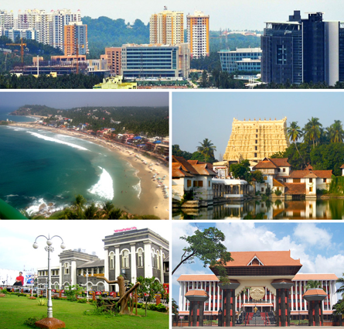
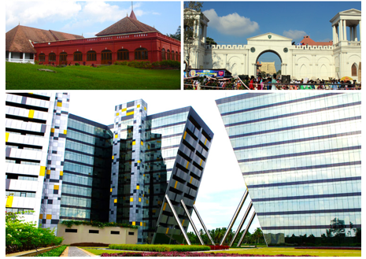
My parents’ home town -Trivandrum, Kerala, southern state of India

Slide 4
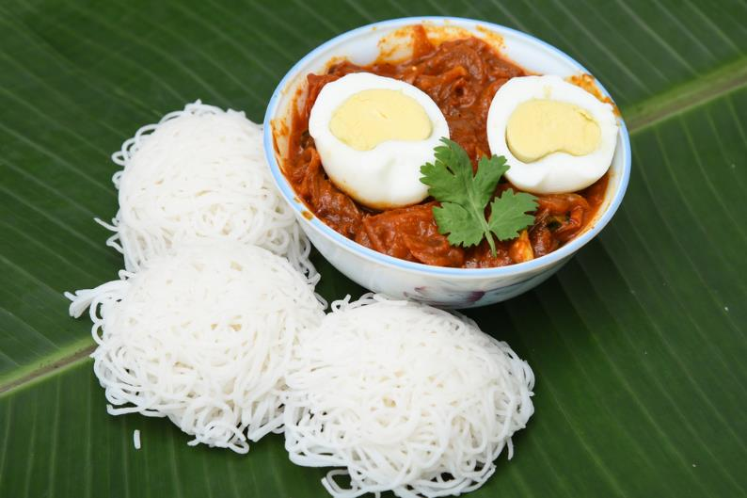
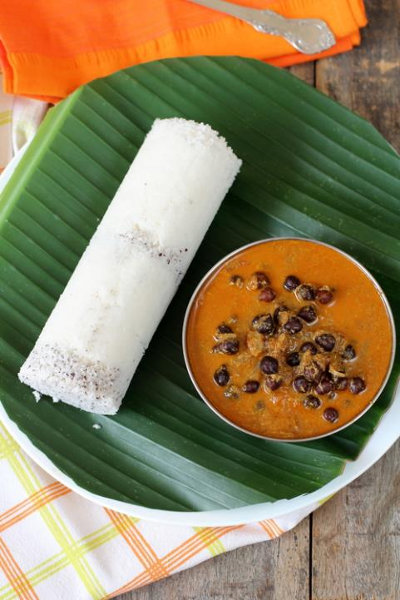
Food I eat at home!
Idiyappam with curry
Breakfast

Slide 5
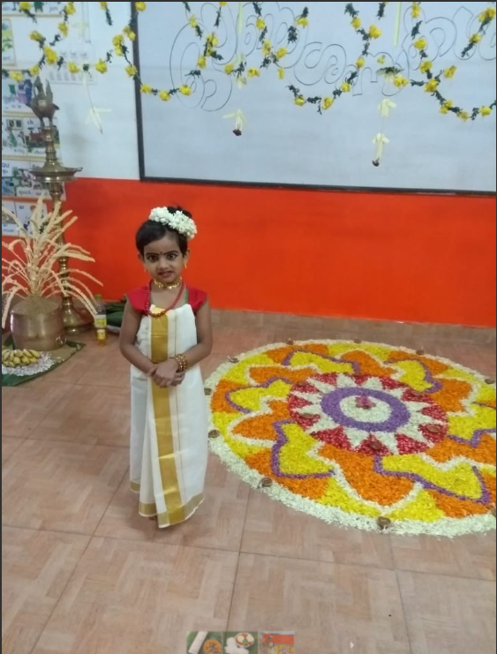
The main cultural festival is Onam. It is a harvest festival celebrated during August - September.

Slide 6
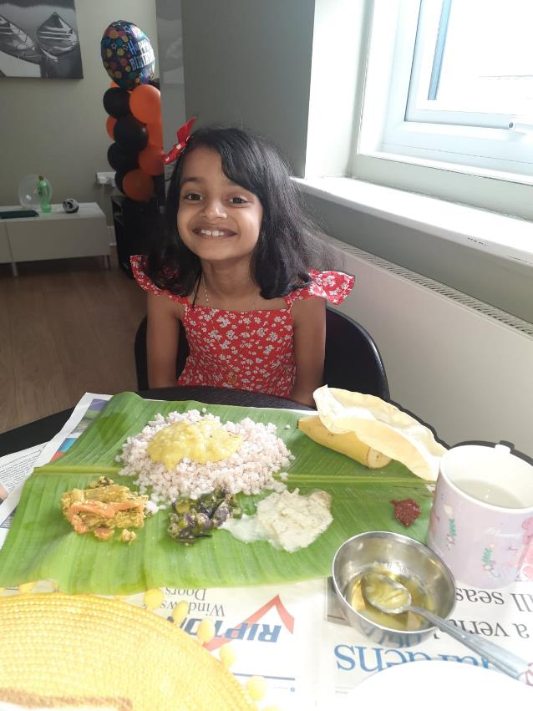
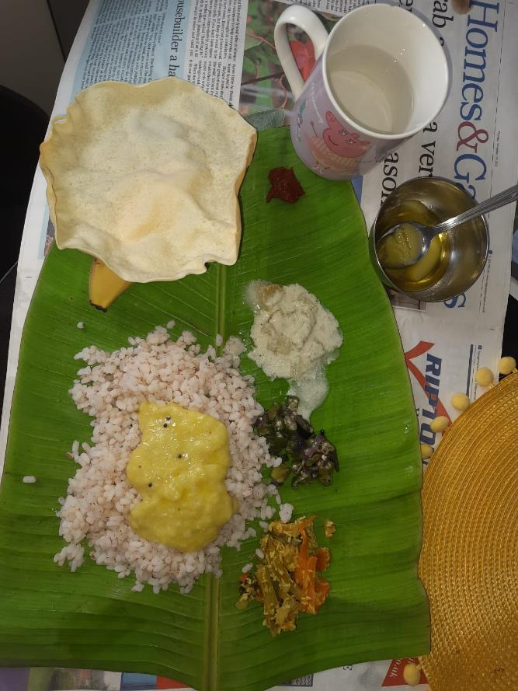
Food at the festival- Onam
Sadya

Slide 7
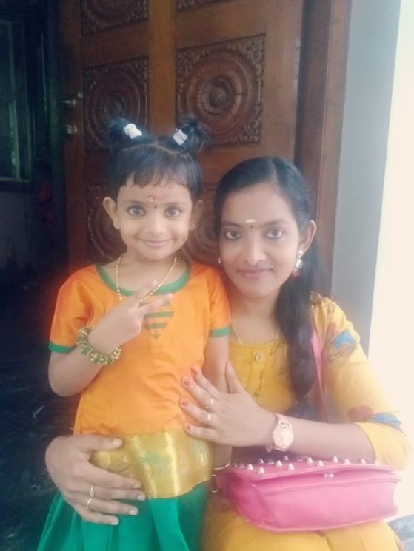
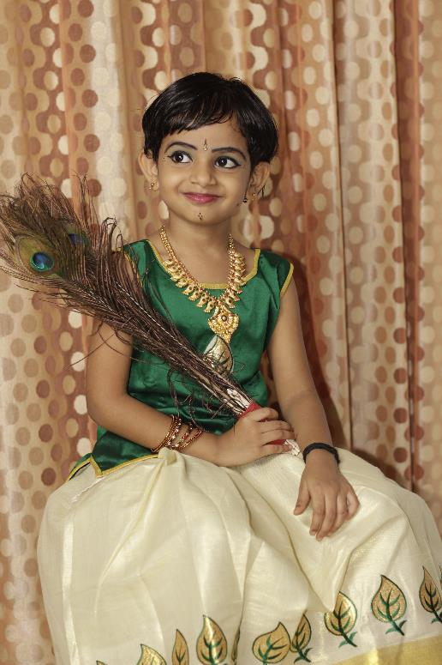
Traditional dress
In India!!!

Slide 8
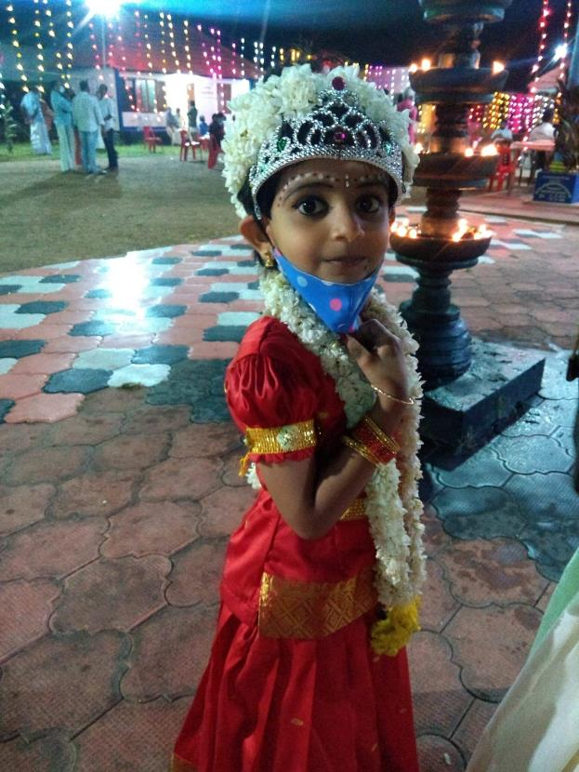
Festival at the temple

Slide 9
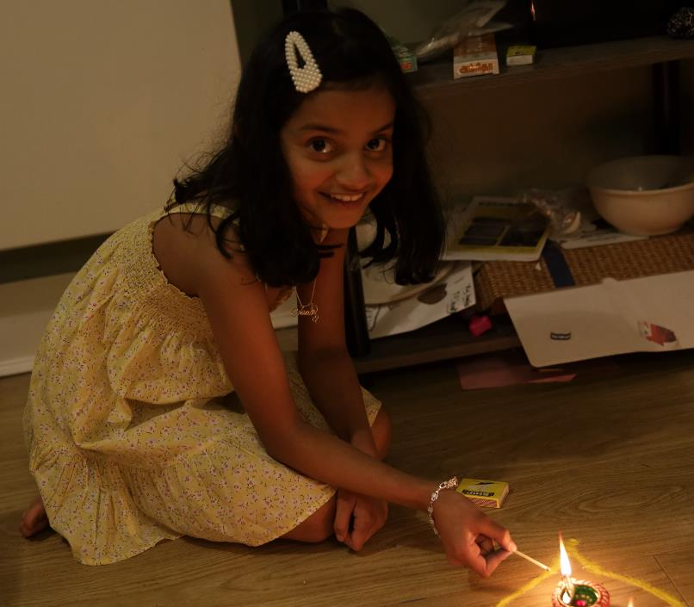
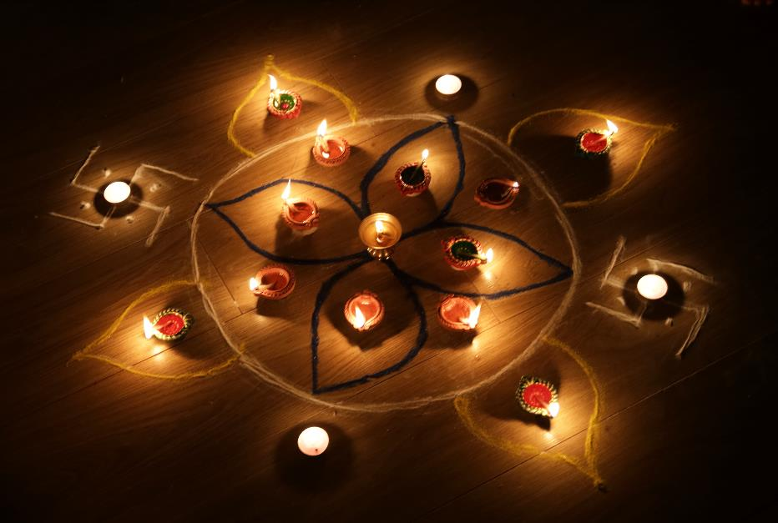
Celebrating Diwali
Diwali is a festival of lights.
It brightens my house when I lit the candles.

Slide 10
Thanks to Nicole for helping me with my Power point.
Nicole is from Poland!!

