Slide 1
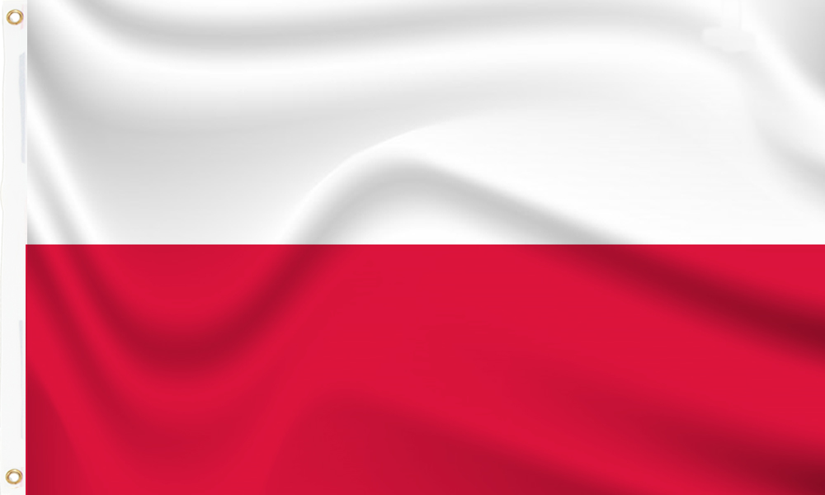
Belonging Week
Oliver – Y3
Amethyst Class

Slide 2
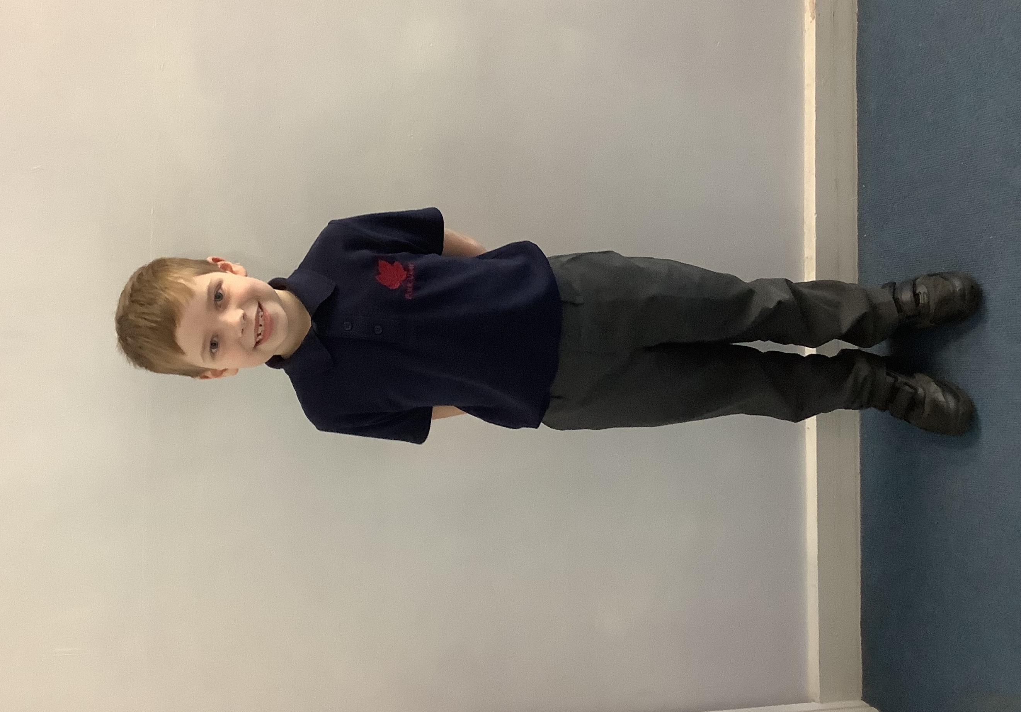
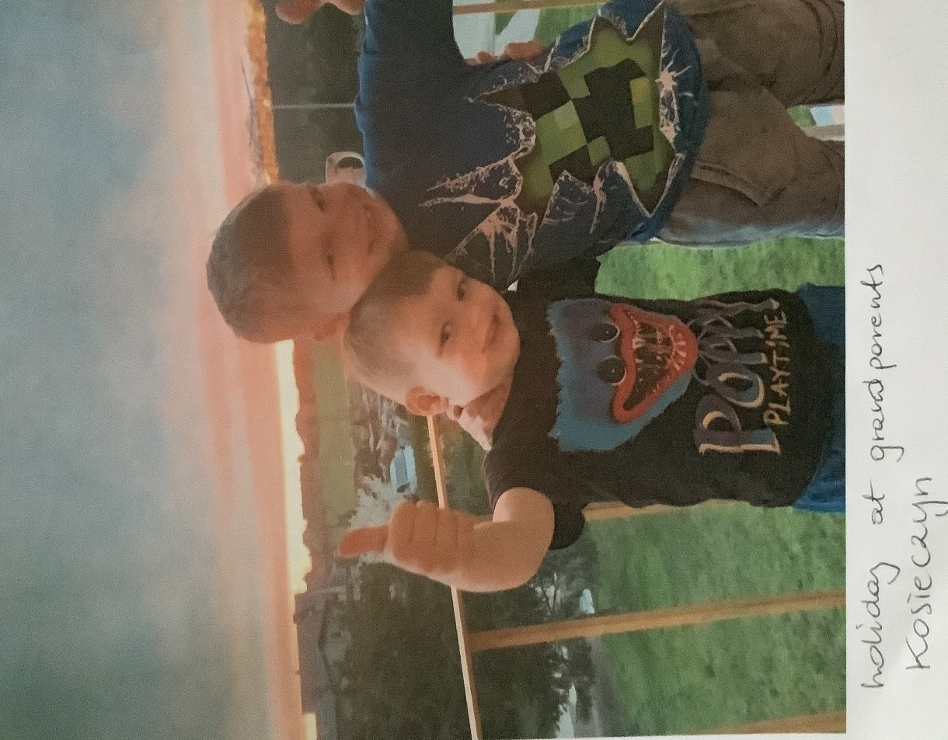
Hello, my name is Oliver. I want to tell you about myself.
I was born in Basingstoke but my parents are from Poland.
I Iive with my mum ,my dad and my younger brother.
The rest of my family are in Poland.
I have BIG family!
Me and my brother in Poland!

Slide 3
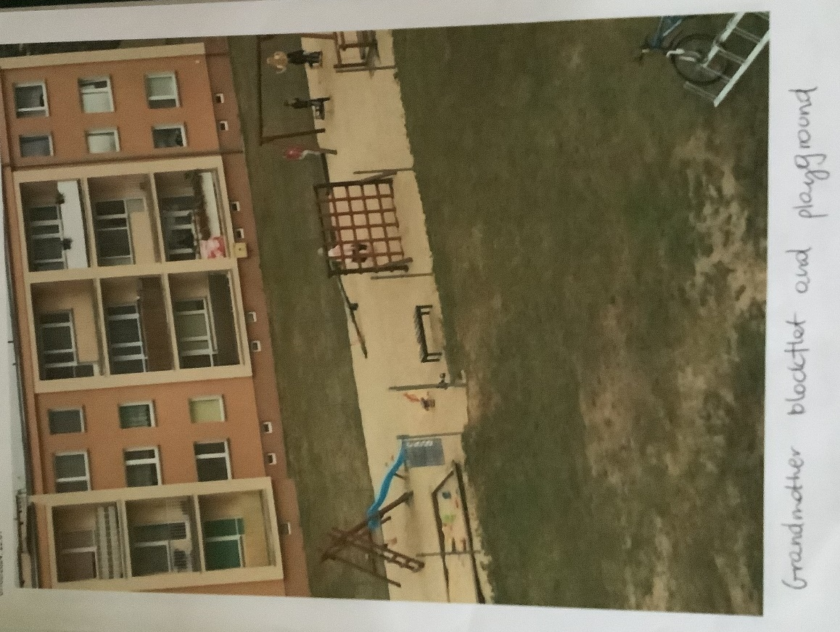
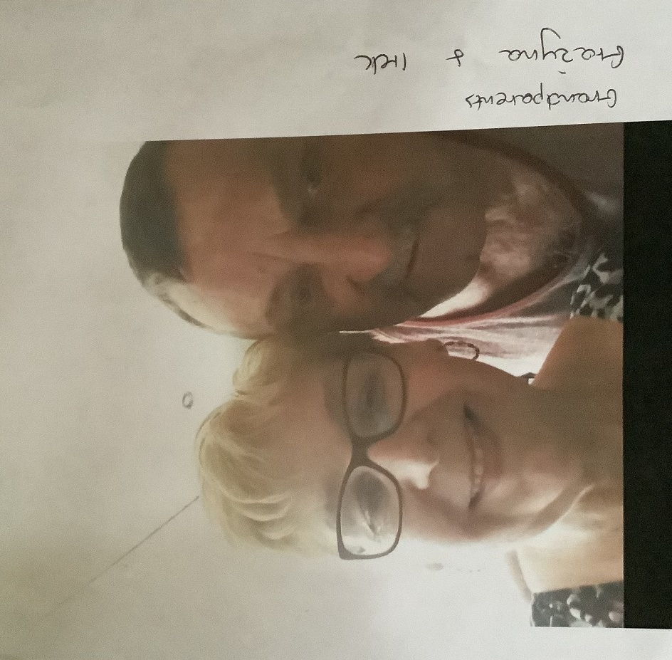
I visit my family in Poland every year!
My nan’s block of flats in Poland!
Nan and granddad

Slide 4
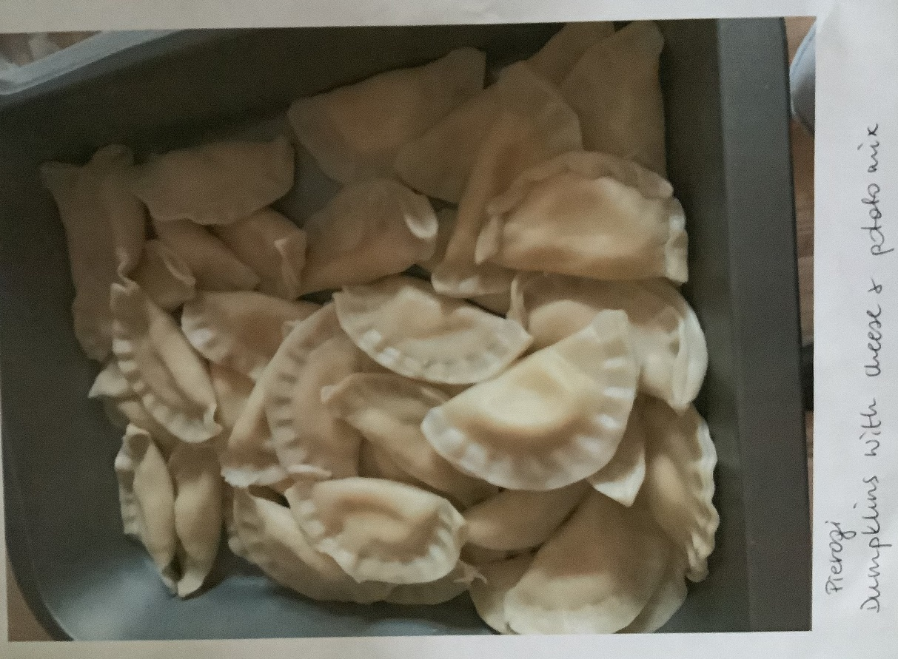
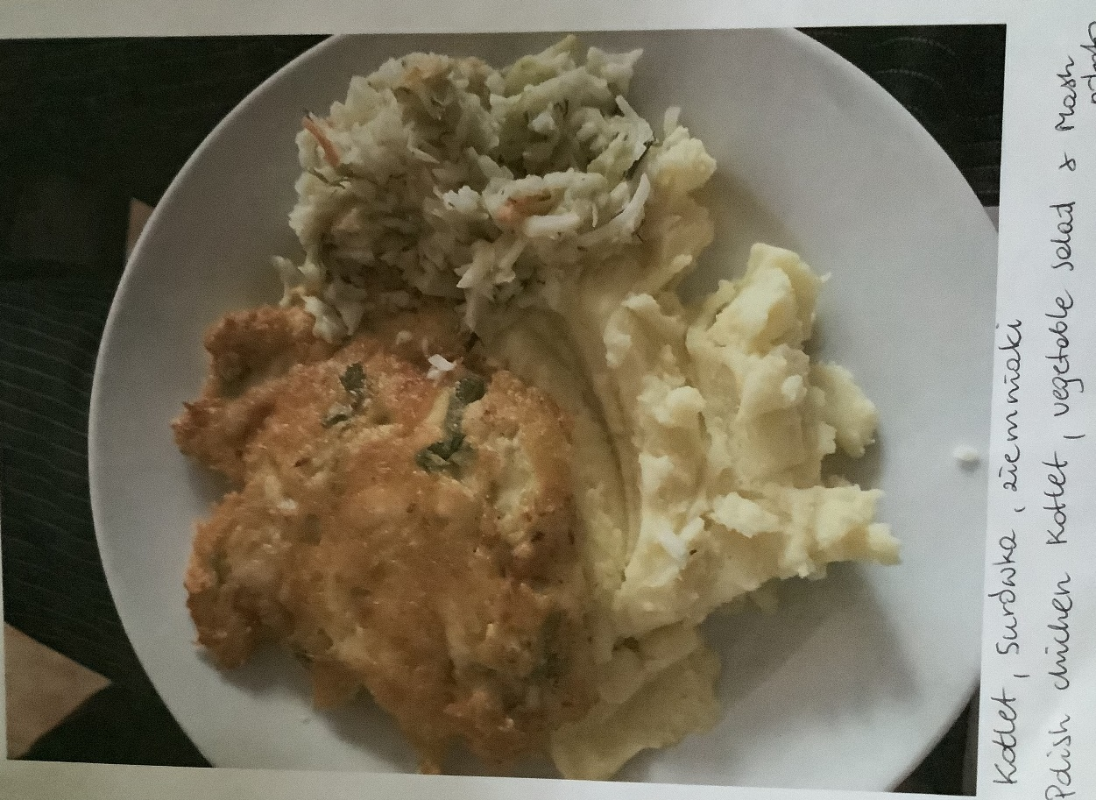
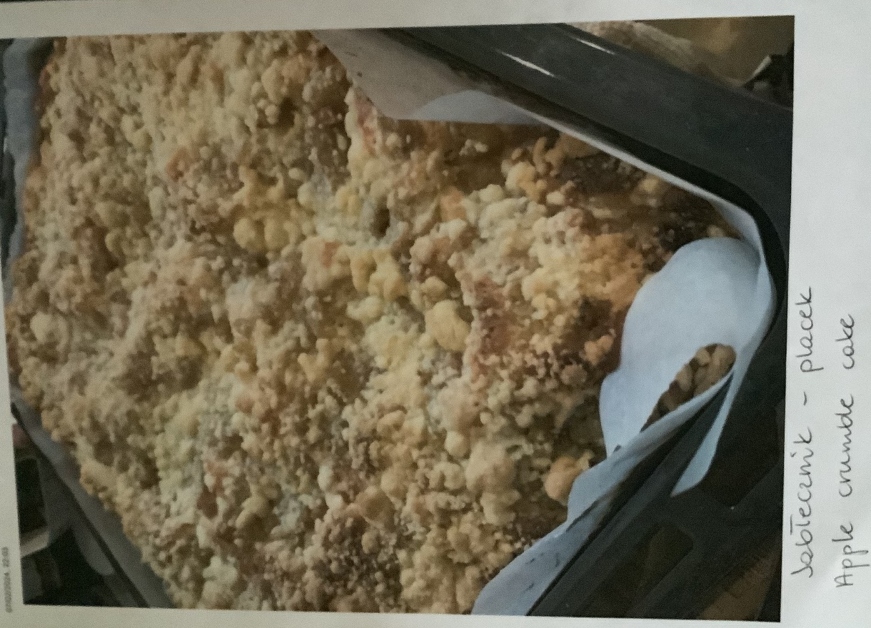
At home I eat…
Polish Chicken - Kotlet
Apple crumble
Dumplings- Pierog

Slide 5
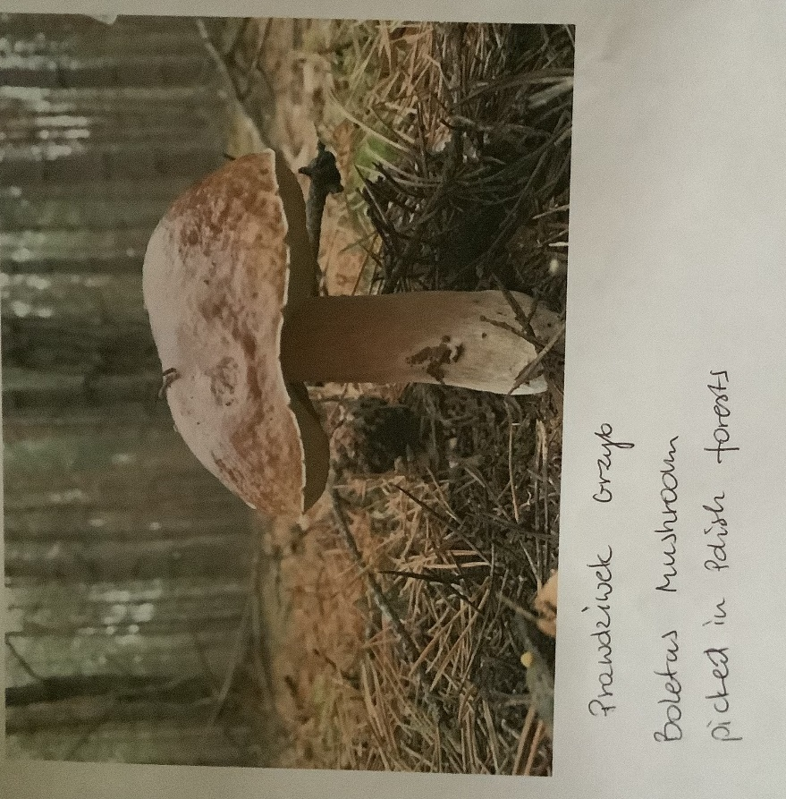
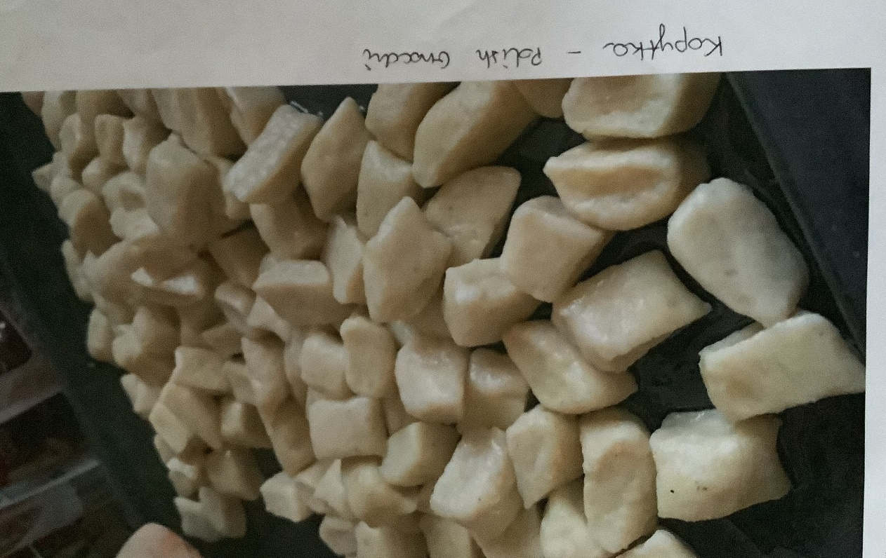
More food…
Polish Gnocchi
We pick mushrooms from the forest.
Adults check to see that they are not poisonous.

Slide 6
What I like to do in my spare time
At home
At school
I play games online with my friends.
I ride my bike on the playground near this school.
I sometimes play football.
I like drawing because it calms me down when I'm stressed.
I play with Emma at school
We play different games and we also go the equipment.
Sometimes I play with Olivia, she has helped to make this PowerPoint.

Slide 7
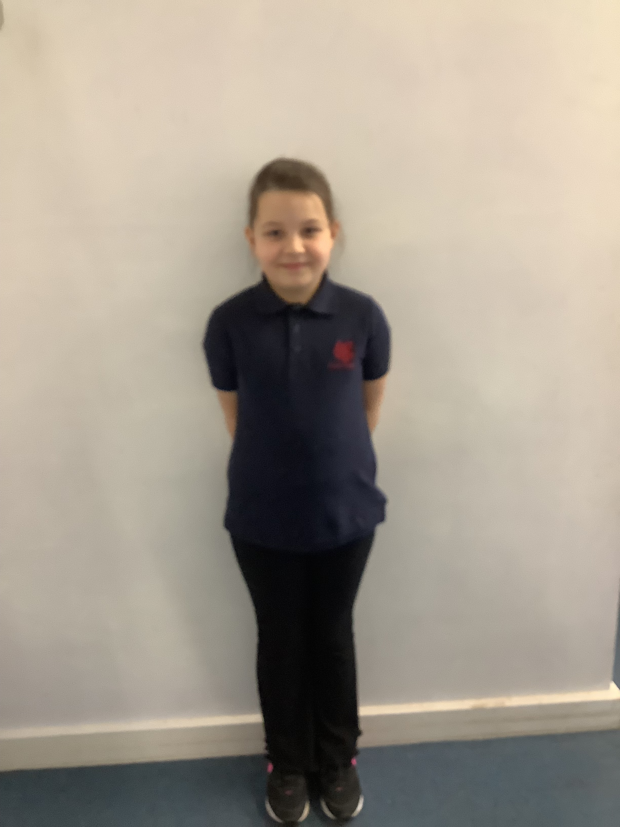
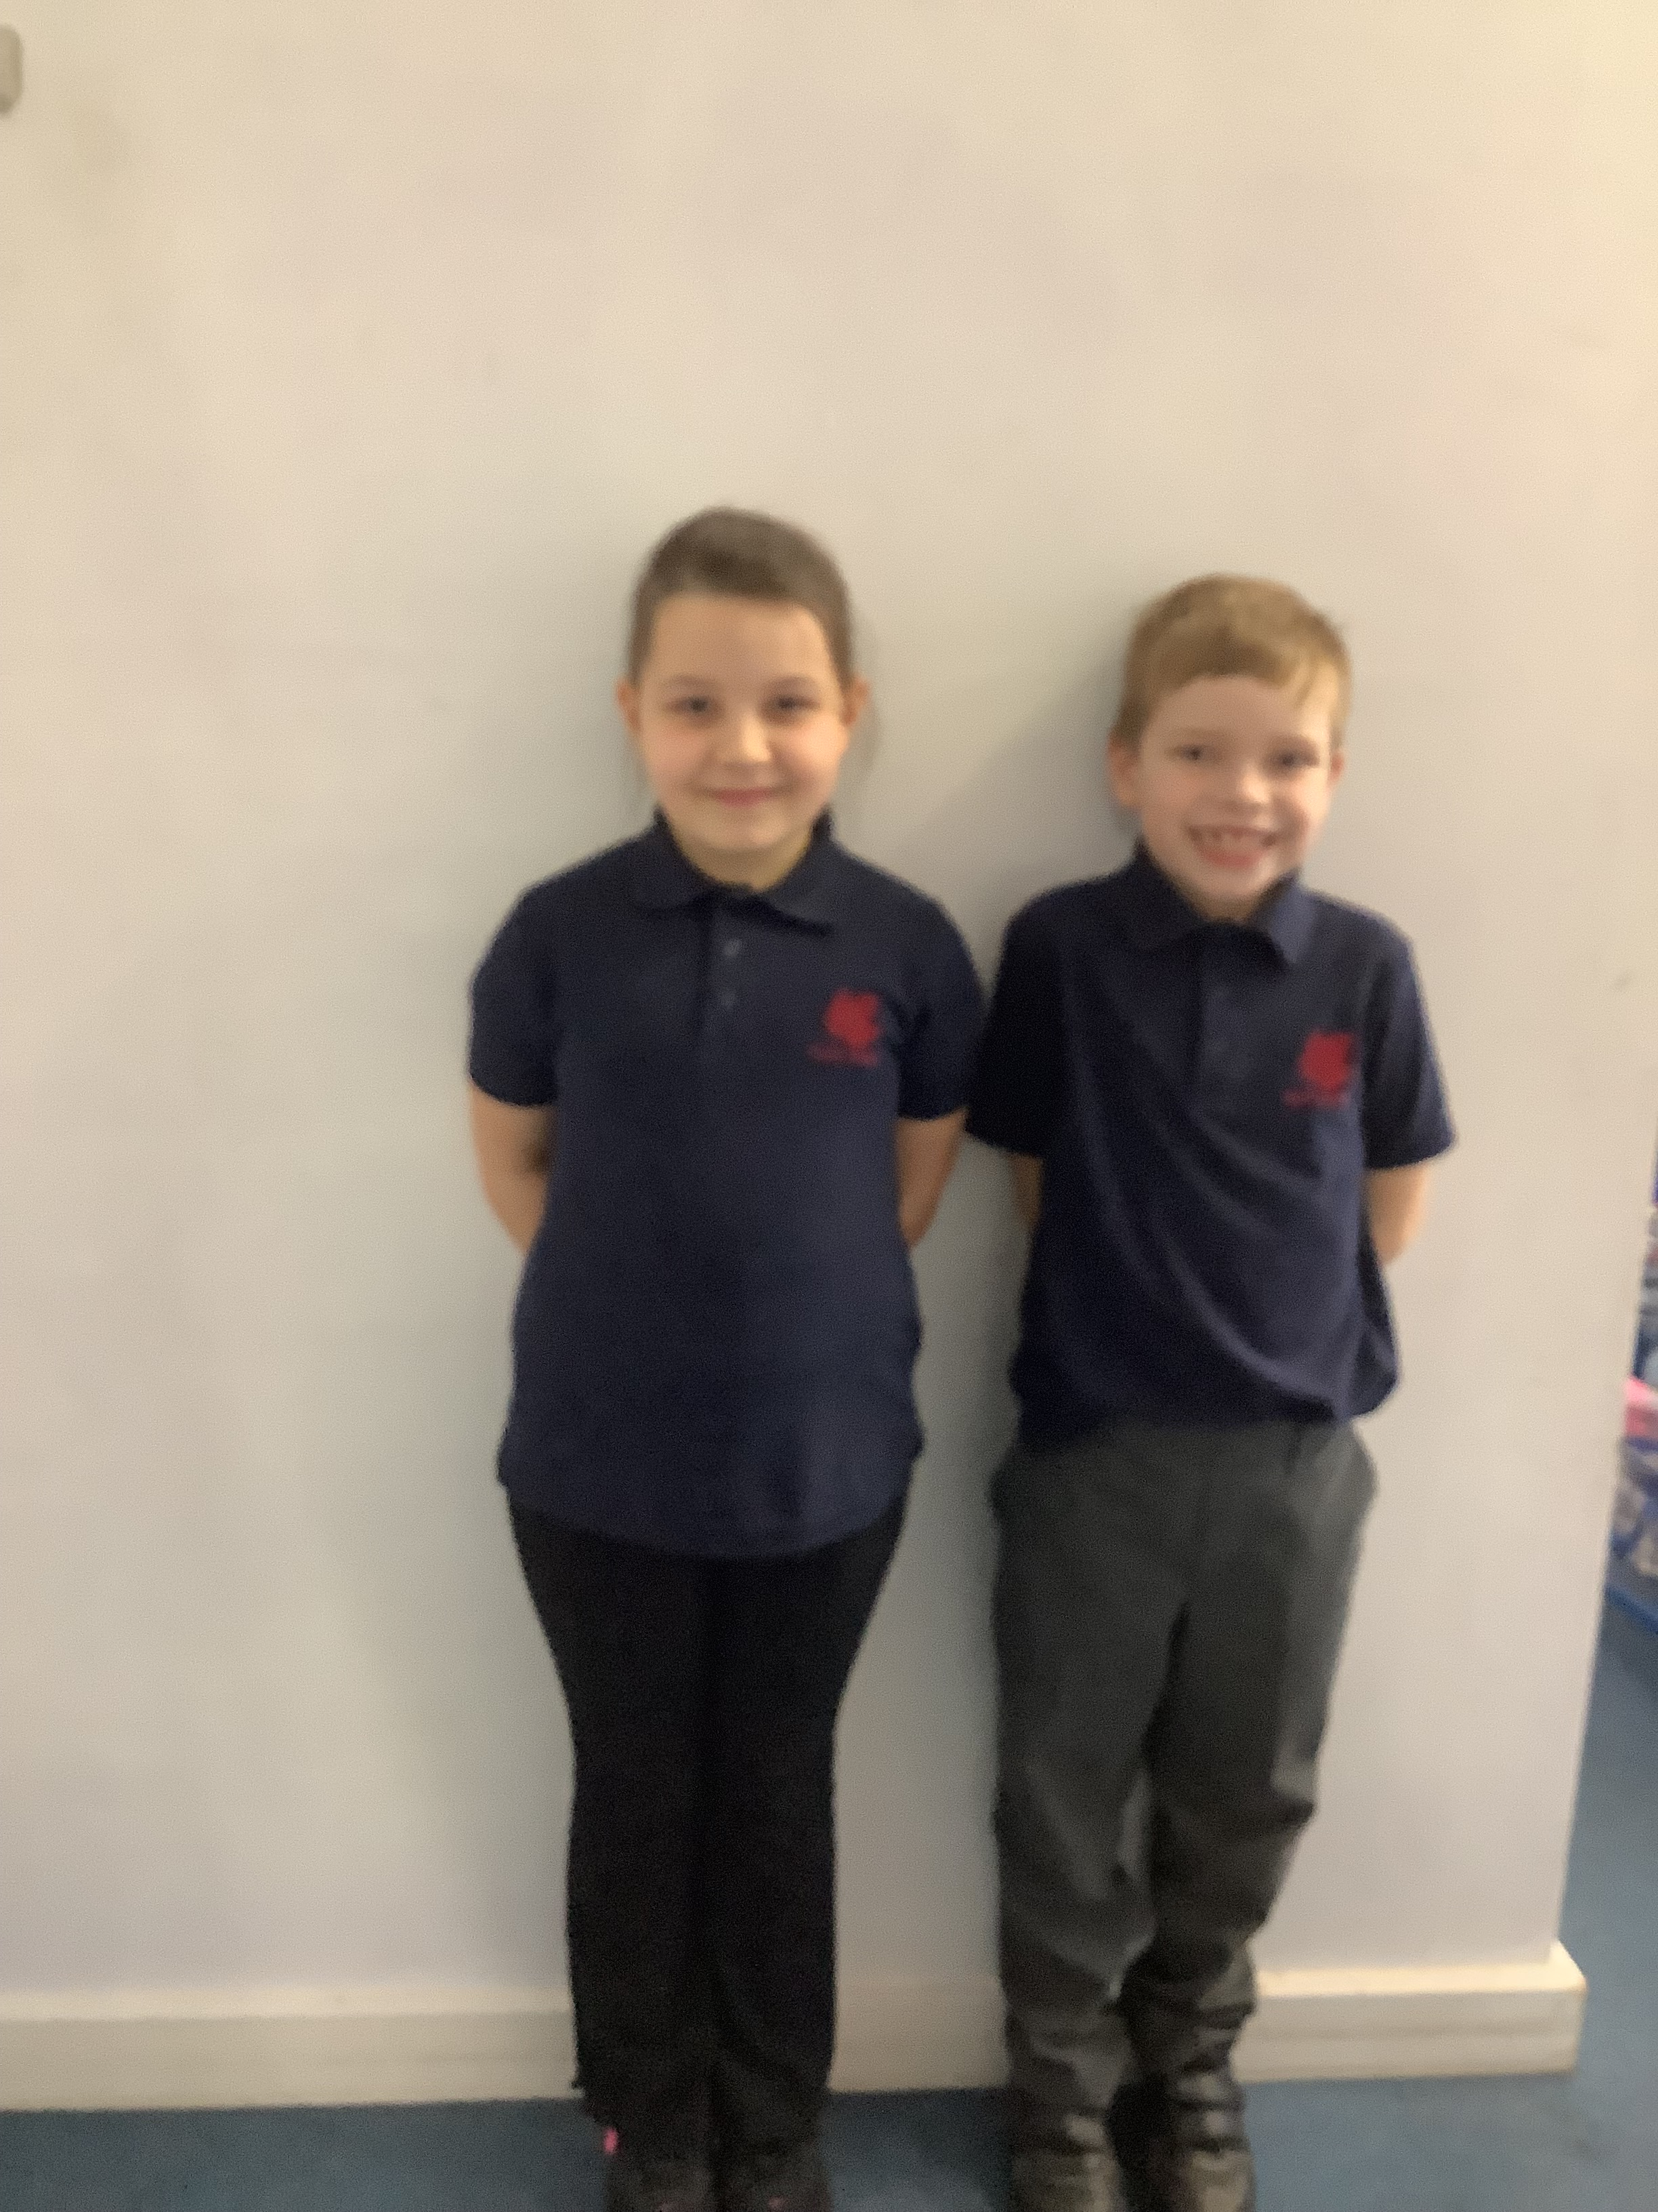
Oliwia also come from Poland.
Oliwia was also born in England just like me.
Oliwia’s parents were born in Poland.
Just like me , she has a big family too.
Oliwia has just been to Poland for Christmas

