Slide 1

Celebrating diversity and Inclusion.

Slide 2
Who am I?
Where was I born?
Where did I go to school?
Do I speak a different language?
How did I end up in the UK?
When did I become a teacher?
Why is my skin colour darker?
Is Africa a country?

Slide 3
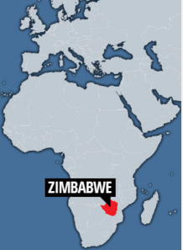
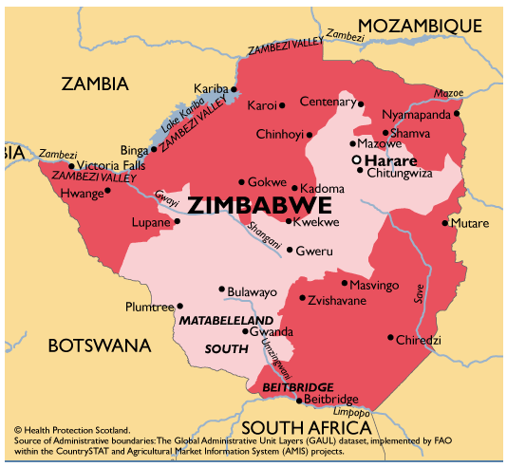

Slide 4
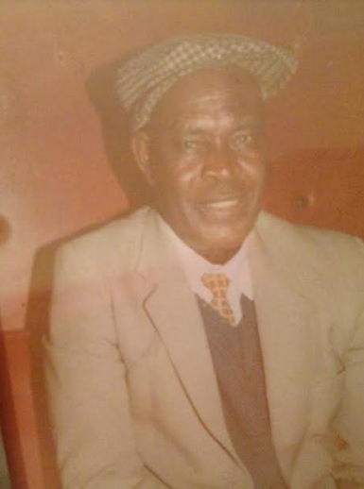
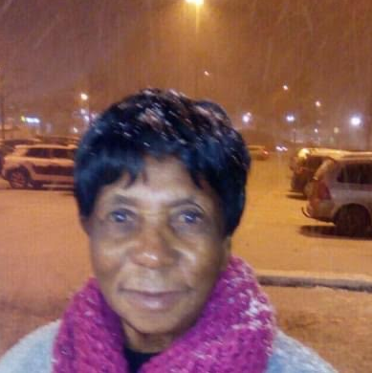
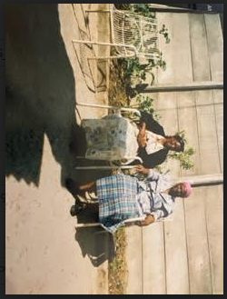

Slide 5
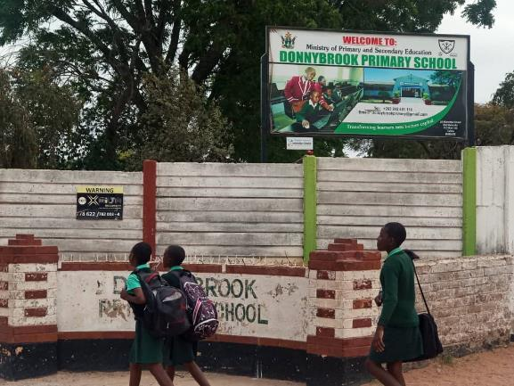
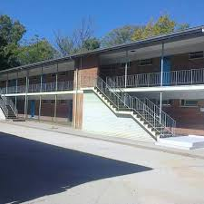
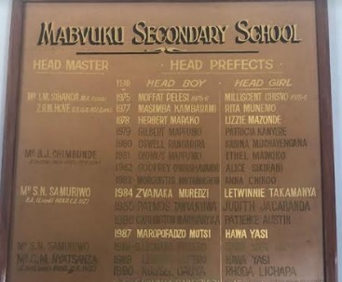
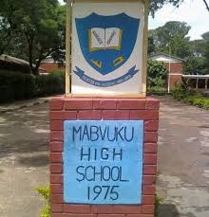

Slide 6
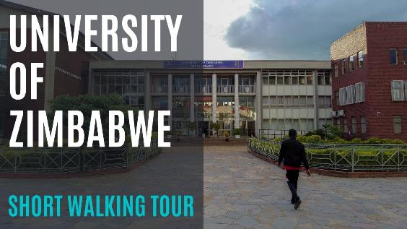


Gweshe Primary
Southerton Primary
Batanai Primary
Project Planning and management

Slide 7
Things I like doing…
Helping other people -(charity that supports children in Zim and overseas - my daughter calls it World Remit charity)
Travelling
Walking – any sport
Cooking
Fashion and Sewing
Cleaning
Music and dance
Gardening
Meeting up with friends

Slide 8
Things I don’t like:
Going to the dentist ( but still go anyway)
Rudeness
Chewing
Waiting (when picking up my son)
Queuing at the airport
Getting up too early

Slide 9
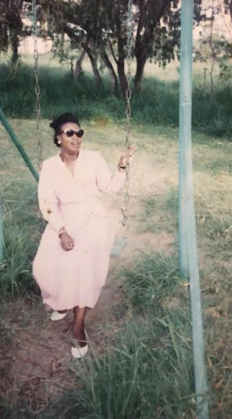
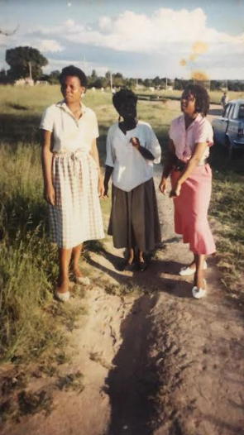
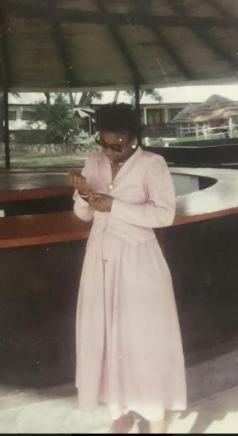
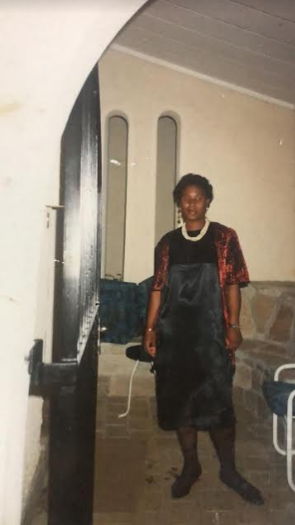
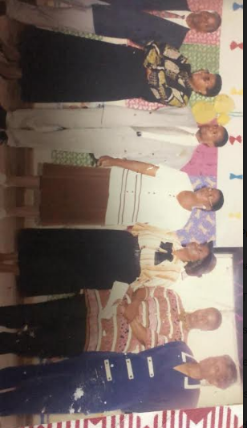
The beginning of my career.

Slide 10
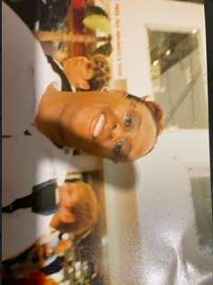
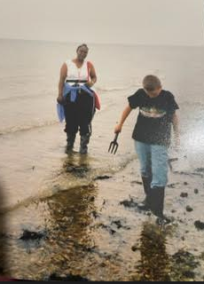
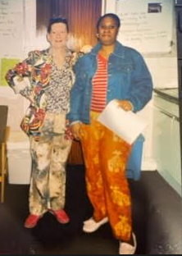
Early days at Park View !

Slide 11
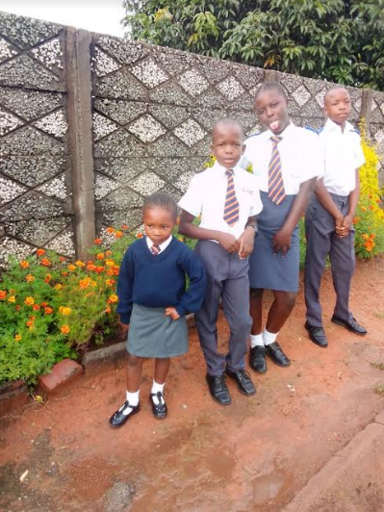
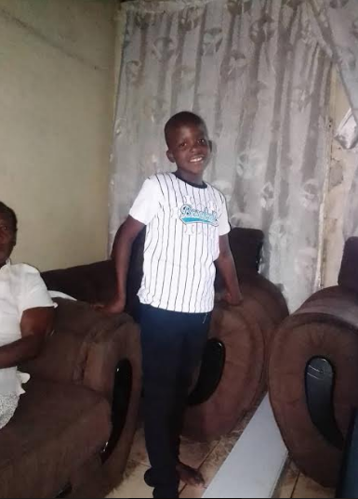
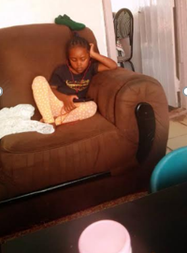
My nieces’ children.
I am a grandmother too !
They call me Gogo ☺

Slide 12
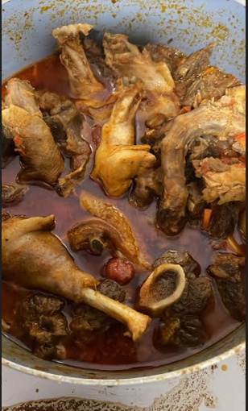
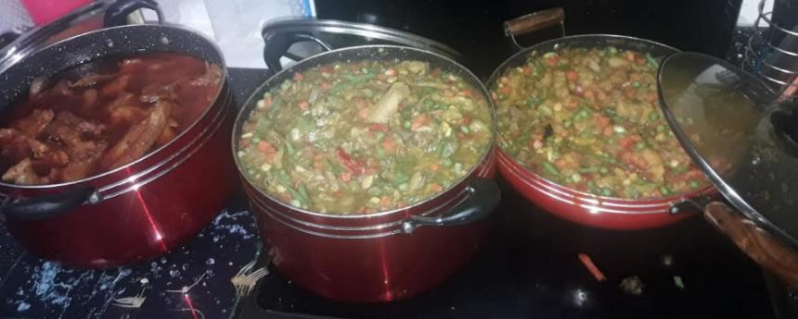
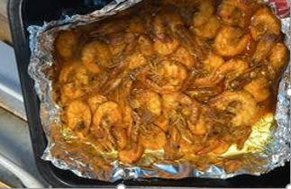
Goat meat
Okra soup
I love cooking!!
Hard chicken
Garlic prawns

Slide 13
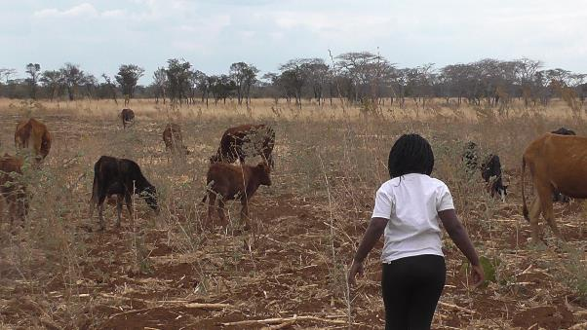
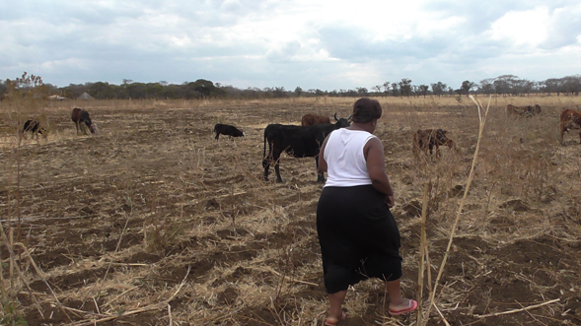
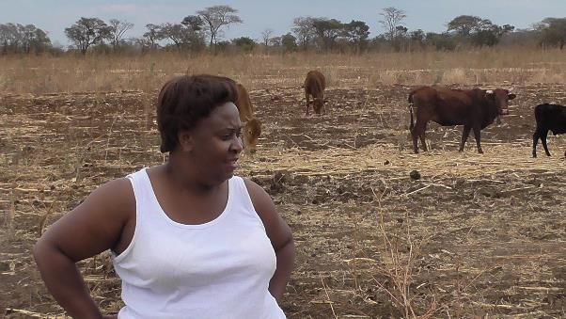
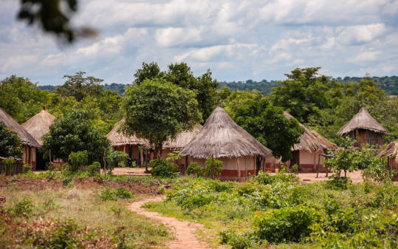
My brother’s farm

Slide 14
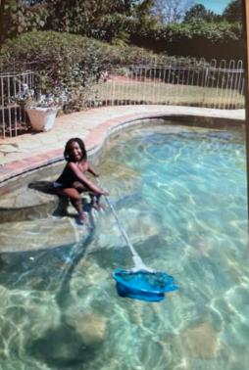
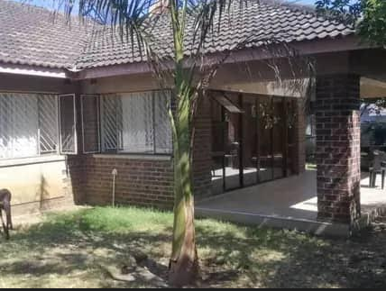
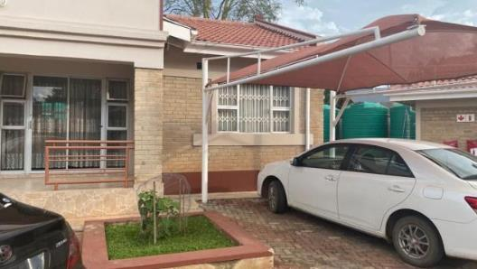
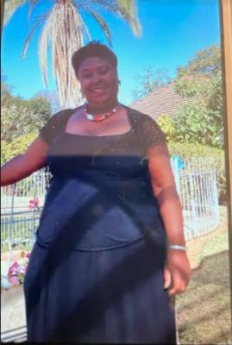
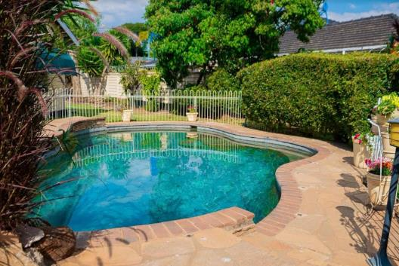
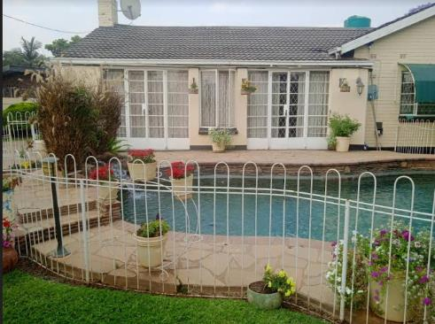
Mrs Pfende’s house

Slide 15
Reflection
We are different and unique but we are all equal.
Zimbabwe
Africa
Some of the things you like , I like too.
We may have different cultures but we have a Park View Culture .
Shona
Some people in this school speak different languages too.
Being born in a different country does not make you less of a person.

Slide 16
Challenge!
Would you like to share your story?
Register your interest with me or Mrs Owens.
We would love to hear your story!
Be proud of yourself and who you are!!

