Slide 1
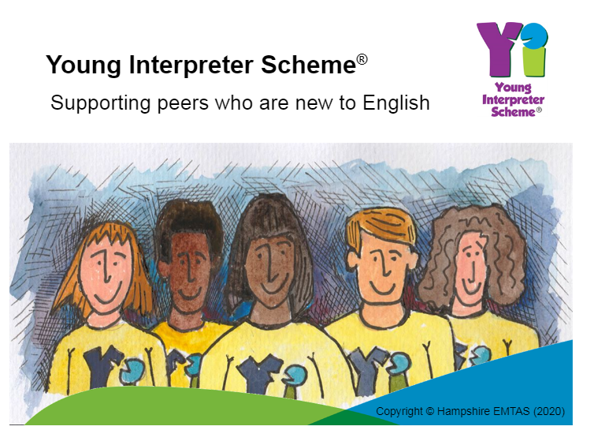

Notes:
Morning everyone – we want to let you know about an exciting new opportunity that you may want to be involved in.
‘Do you think you have got what it takes to be a Young Interpreter?’

Slide 2
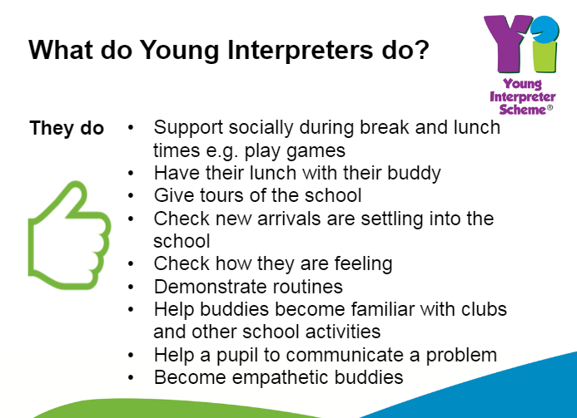
Notes:
First of all – What is a ‘Young Interpreter’?
Have you ever thought what it would be like to go to a new school where you didn’t speak the language? It could be really quite frightening – not knowing what people are saying, why are they laughing, not knowing where to go or what the school routines are?
Young Interpreters will be a small group of selected children that will be able to help. You may be a friend to new children coming into Park View, show parents around who are wanting to choose a school for their child, help the new arrival to feel more at home and you might just be that friendly face and smile that they need.

Slide 3
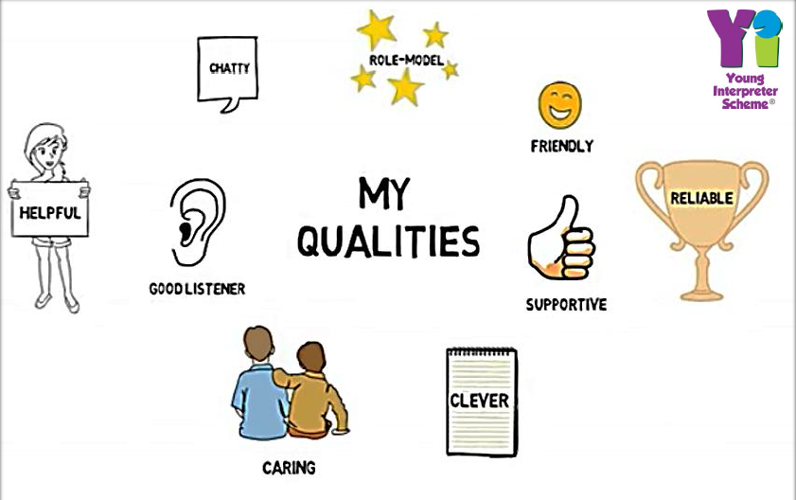
What qualities do you think you need?
Notes:
Have a look at this slide – do you think you need all of these qualities to be a Young Interpreter? Are there any that aren’t that important and what ones could you add?

Slide 4
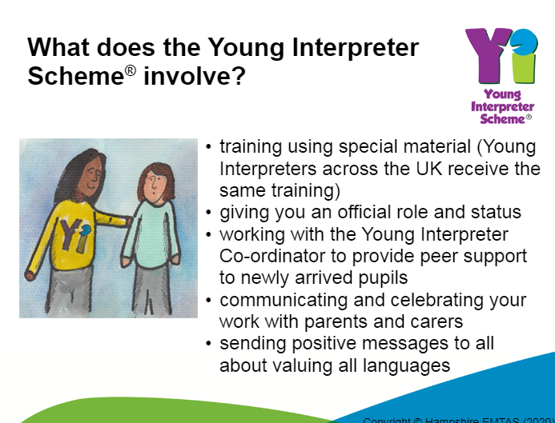
Notes:
Interested? What will you have to do to become a Young Interpreter?
You will have some specific training that has been put together by experts from Hampshire County Council.
Mrs Keeping and Mrs Roberts will be looking after you.
When you have completed your training you will be given a Certificate and a Young Interpreter badge that you can wear proudly on your uniform.
You can lead the all the positive things that happen and celebrate all that is good about the diverse range of languages and cultures that we have in our school

Slide 5
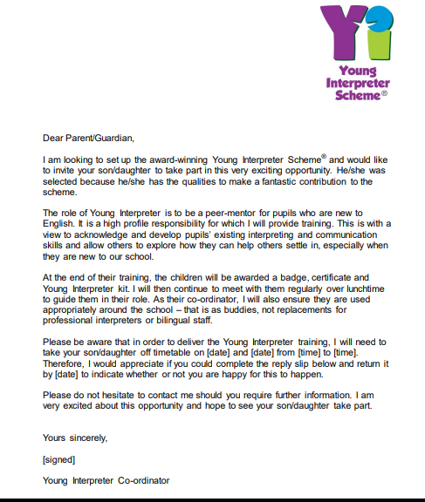
Notes:
Pick up a letter from your teacher and we look forward to seeing you at our first training session.

