Slide 1
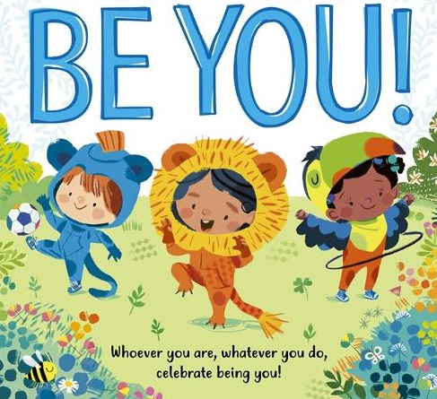




All About Me!
Pumpkins & Sunflowers
Autumn Term 1 2026
Maths
Matching, sorting and comparing amounts
Starting School – Following Rules
I can listen carefully and understand the purpose of having rules.
My Home and Family
I can visually represent my family and understand that all families are different.
English
Pre writing skills, name writing and mark making.
Wider Learning
Tour of the school
School disco to fundraise for the school.

Slide 2


All About Me!
Pumpkins and Sunflowers
Autumn Term 1
Wider learning at home
• You could make a family tree with your child to bring into school and share.
Bring into school a picture of you (child) as a baby.
https://www.youtube.com/watch?v=pzmB0GoEKkA&list=RDpzmB0GoEKkA&start_radio=1
Practise your number formation
Practise writing your name on your home template.
English:
Learning to Write our names
Mark making
Pre writing skills
Maths:
Matching, sorting and comparing amounts
Wider learning:
School disco to raise funds for the school
Stories
We will be sharing stories about starting school, emotions and things we enjoy doing.
PSHE
Learning about families and having an understanding that all families are different.

