Slide 1
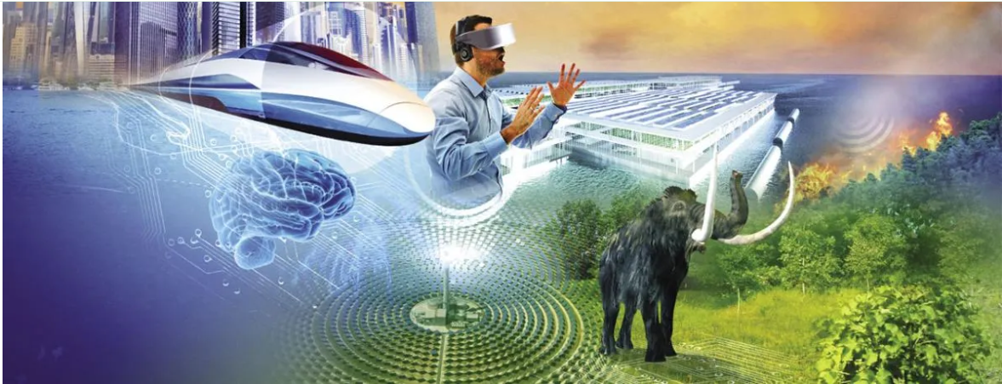
Can we change our future?
Autumn Term 1 2026
English
Song of a Dolphin Boy
Inspired by the book, we will write descriptions of the sea, our own endings of a chapter and a non-chronological report about our own sea creature. Finally, we will write a formal letter presenting our opinions on climate change.
Geography
We will learn about weather patterns around the world and how they are becoming less predictable due to climate change.
Art
Drawing and Painting
We will explore different drawing techniques and the application of water colour paints. We will produce a lifelike pencil drawing and a painting of a sea creature.

Slide 2

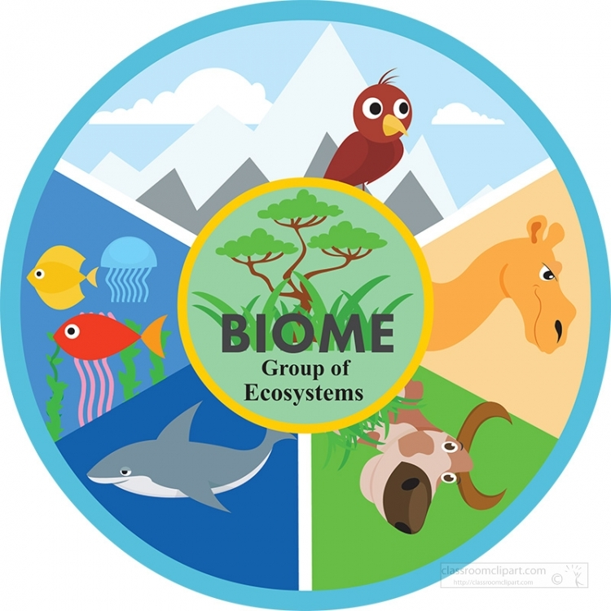



Wider learning at home
• Have you ever been on a day trip or holiday where you have found an exciting object or animal—write a detailed description of it.
• Learn to spell your name in sign language.
• What 5 things would you take on a desert island with you and why?
• Write a message to inspire someone.
• Make some top trump cards about the different biomes around the world
What shapes our world and lives?
Summer Term 2 2026
English:
Texts drivers: Nelson Mandela—Long Walk to Freedom
There’s a tiger in the garden
Inspired by these books, we will write a report on Nelson Mandela and a story.
Maths: Money/Time/Multiplication and Division
Add and subtract amounts of money to give change , Name features of different shapes, Statistics, consolidate our knowledge of 3, 4, and 8 times table.
Science
Add and subtract amounts of money to give change , Name features of different shapes, Statistics, consolidate our knowledge of 3, 4, and 8 times table.
Geography
We will be exploring and comparing the different biomes around the world.
DT
Linkages and levers:
Making a moving part for a biome box
RE
Hindu celebration of Raksha Bandhan.
PE
This term we will be developing athletic skills / rounders/cricket.

