Slide 1

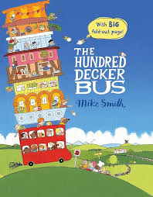
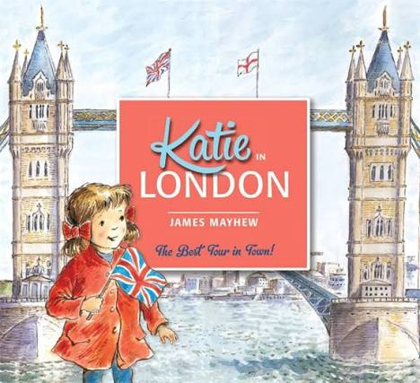
Is the UK a good holiday destination?
Autumn Term 1 2026
English
We will begin by writing
narratives based on ‘The
Hundred Decker Bus’ with a
specific focus on descriptive
language.
After this, we will move on to retelling the story of ‘Katie in London’.
Geography
We will learn about the four nations of the United Kingdom: England, Scotland, Wales and Northern Ireland.
During these lessons, we will be looking at their capital cities, natal landmarks, symbols, flags and traditions.
Art
We will look at the work of Ilona Drew, explore a variety of drawing techniques and create artwork of a London landmark.

Slide 2







Wider learning at home
We encourage the children to read 4 times a week at home, as well as practising their spellings and number bonds.
• Call or video chat with friends or family who love in different parts of the UK. What is similar and different?
Watch a relevant ‘Go Jetters’ episode: Stonehenge, Giant’s Causeway, Big Ben, Loch Ness, Caernarfon Castle, Dover and Tower Bridge. https:// www.bbc.co.uk/iplayer/episodes/ m0007z03/go-jetters? seriesId=m0007z03-structural-1- b06l1w5z
Find out 3 facts about a famous person from each of the four nations of the UK.
Use the following link to go on a virtual tour of the Houses of Parliament! https:// virtualtour.parliament.uk/ palaceofwestminster
All of the Year 2 team appreciate the hard work you put in with your child. It really makes a difference!
Is the UK a good holiday destination?
Autumn Term 1 2026
English:
Texts drivers: The Hundred Decker Bus and Katie in London
We will begin by writing narratives with a specific focus on descriptive language. After this, we will move on to retelling the story of ‘Katie in London’.
Maths:
In the first half term we will be revisiting number and place value, addition, subtraction and money.
Science:
During our Science lessons, we will be investigating what animals need to survive and their habitats.
Geography:
We will learn about the four nations of the United Kingdom: England, Scotland, Wales and Northern Ireland.
During these lessons, we will be looking at their capital cities, natural landmarks, symbols, flags and traditions.
Art:
We will look at the work of Ilona
Drew, explore a variety of drawing techniques and create artwork of a London landmark.
My Happy Minds:
We will begin the year by ‘Meeting Our Brain’.
RE:
We will learn about the Jewish harvest festival of Sukkot, including how it is celebrated.
PE: This term we will be improving our ‘Sports Fundamentals’ as well as our ‘Ball Skills’.

