Slide 1
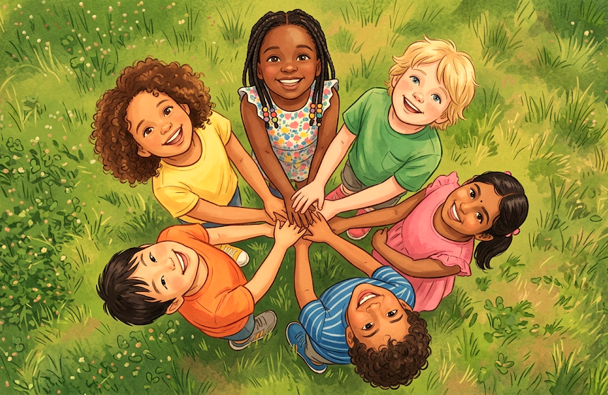
How can I build the bets me?
Autumn Term 1 2026
English
Our Class is a Family
Producing our class chater
Super Duper Me
Writing a fact file about ourselves.
Geography
Local study: Where live
South Ham in Basingstoke
Fieldwork and map work
Science
The human body and senses

Slide 2

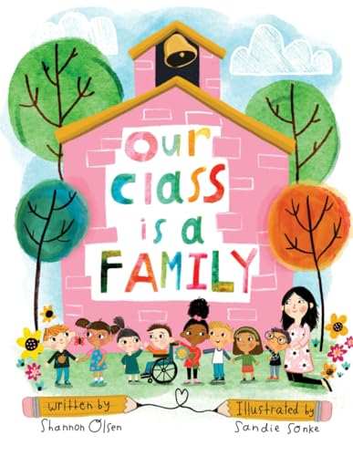

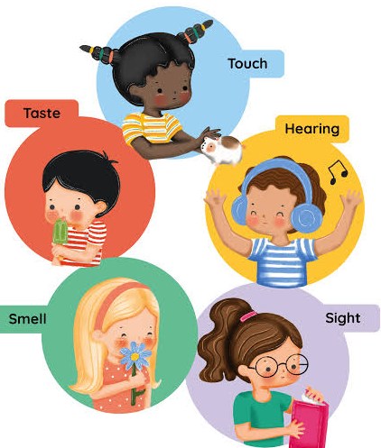
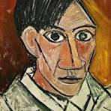
Wider learning at home
Talk to you parents, grandparents and other friends or family about what life and school was like when they were 5 or 6.
· Create a family tree and draw portraits for each member of your family.
· Enjoy the great outdoors and
do some exercise with your
family.
· Go on a number hunt with
your family and friends and
see where you can find lots
of different numbers.
· Help your grown up prepare
a meal and talk about all the
different ingredients and the
different colours you can see
on the plate.
· Look at yourself in the mirror
and point to your nose, eyes
and mouth.
How can I Be the Best Me?
Autumn Term 1 2026
English:
Texts drivers: Our Class is Family
Super Duper ME
Maths:
Number and Place value
Science: the Human body and senses
We will learning about our bodies and our senses. We will know that we have five senses: sight, hearing,
touch, taste and smell. We will also learn how to take care of our bodies by maintaining a balanced diet.
Geography
Local Area study. Looking at features of South Ham. Using our fieldwork and map skills.
Art
We will look at different materials and equipment we can
use to create art. We will look at the work of Picasso, Van
Gough and Andy Warhol
We will create a self portrait.
RE
Who is Jesus and why is he important to Christians.
PE
Fitness and Football

