Slide 1
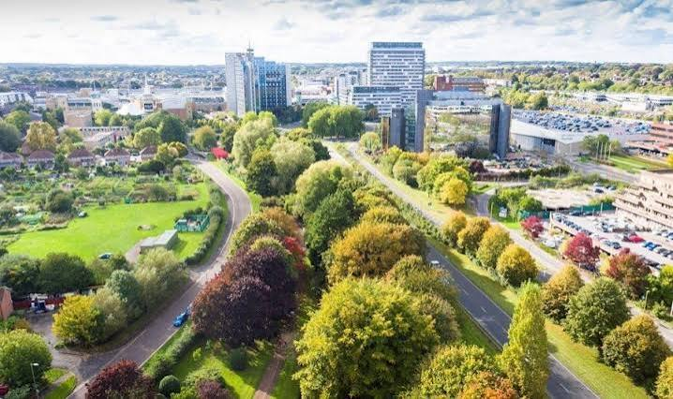
Why am I proud to live in Basingstoke?
Autumn Term 1 2026
Geography
During our geography lessons, we will be learning about the differences between towns and cities. We will also be studying our local area, identifying the key features and creating maps using symbols to show these.
English
This Is How We Do It
Children of the World
This Is Our World
Year 3 will be learning about children from all over the world and creating a range of pieces to showcase this knowledge, including letters and a non-chronological report.
Art
We will be learning about the sculpture artist, Henry Moore, and be designing a clay sculpture in the style of his work.

Slide 2
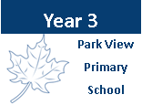



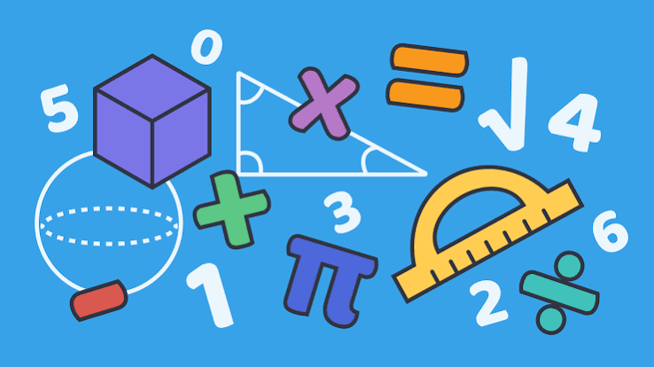

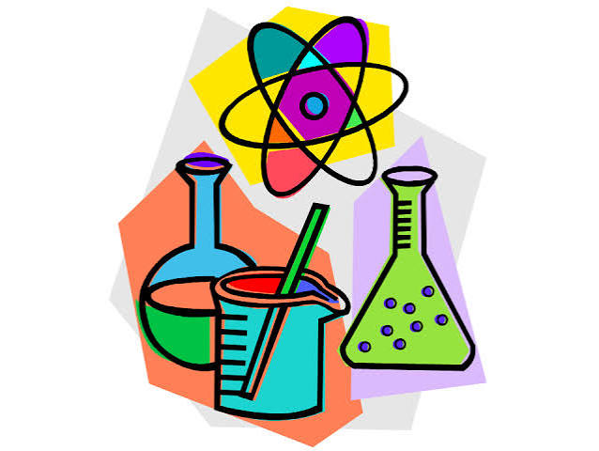

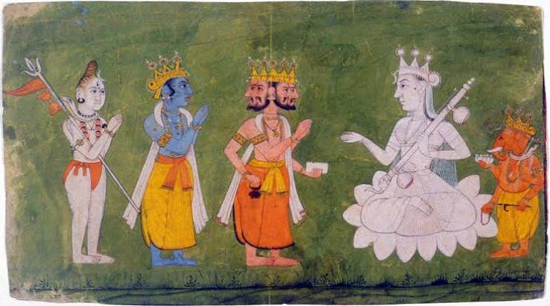

Wider learning at home
We encourage the children to read 4 times a week at home, as well as practising their spellings and times tables.
You could also:
Go on a trip to a local Basingstoke landmark.
Look at a map of Basingstoke in the local library. Are you able to spot the street you live on?
Make a diary of the different fruits and vegetables you eat in a week. Which is your favourite?
Complete the ‘Love Basingstoke’ Play Park Bingo challenge: https://www.datocms-assets.com/74416/1784903165-love-basingstoke-play-park-bingo.pdf
All of the Year 3 team appreciate the hard work you put in with your child. It really makes a difference ☺
Why am I proud to live in
Basingstoke ?
Autumn Term 1 2026
English:
Texts drivers: This Is How We Do It by Matt Lamothe, Children of the World by Nicola Edwards, This Is Our World by Tracey Turner
Year 3 will be learning about children from all over the world and creating a range of pieces to showcase this knowledge, including letters and a non-chronological report.
Maths: Place Value, Addition and Subtraction
We will begin the year by recapping our knowledge of place value before learning about numbers up to 1000. We will then continue to develop and build on our addition and subtraction skills, using formal methods.
Geography
During our geography lessons, we will be learning about the differences between towns and cities. We will also be studying our local area, identifying the key features and creating maps using symbols to show these.
Science
During our science lessons, we will be learning about the importance of healthy, balanced diets. We will then move on to looking at skeletons and muscles.
Art
We will be learning about the sculpture artist, Henry Moore, and be designing a clay sculpture in the style of his work.
RE
Our topic this half term is focused on Hinduism and the importance of shrines.
PE
This half term we will be developing
our fitness and football skills.

